Slide 1
An Approach for Papaya Diseases Recognition Using GLCM and KNN
Submitted by:
Arifin Mahmud
ID: 1504113
Supervised by:
Dr. Kaushik Deb
Professor, Department of CSE , CUET

Slide 2
Contents
Goal
Motivations
Applications
Related Works
Challenges
Implementation
Dataset Description
Result & Discussion
Conclusion
Limitations & Future Work
References

Slide 3
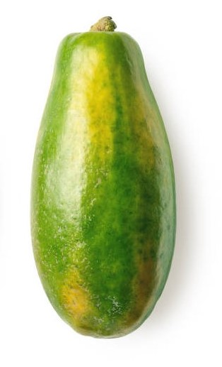
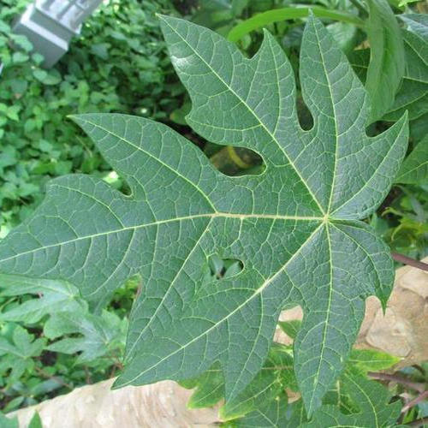
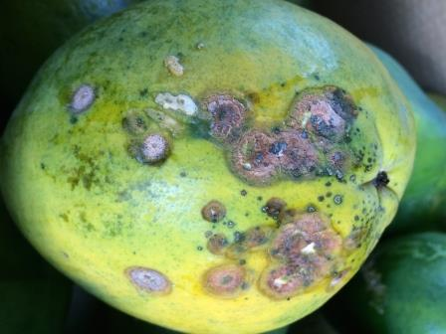
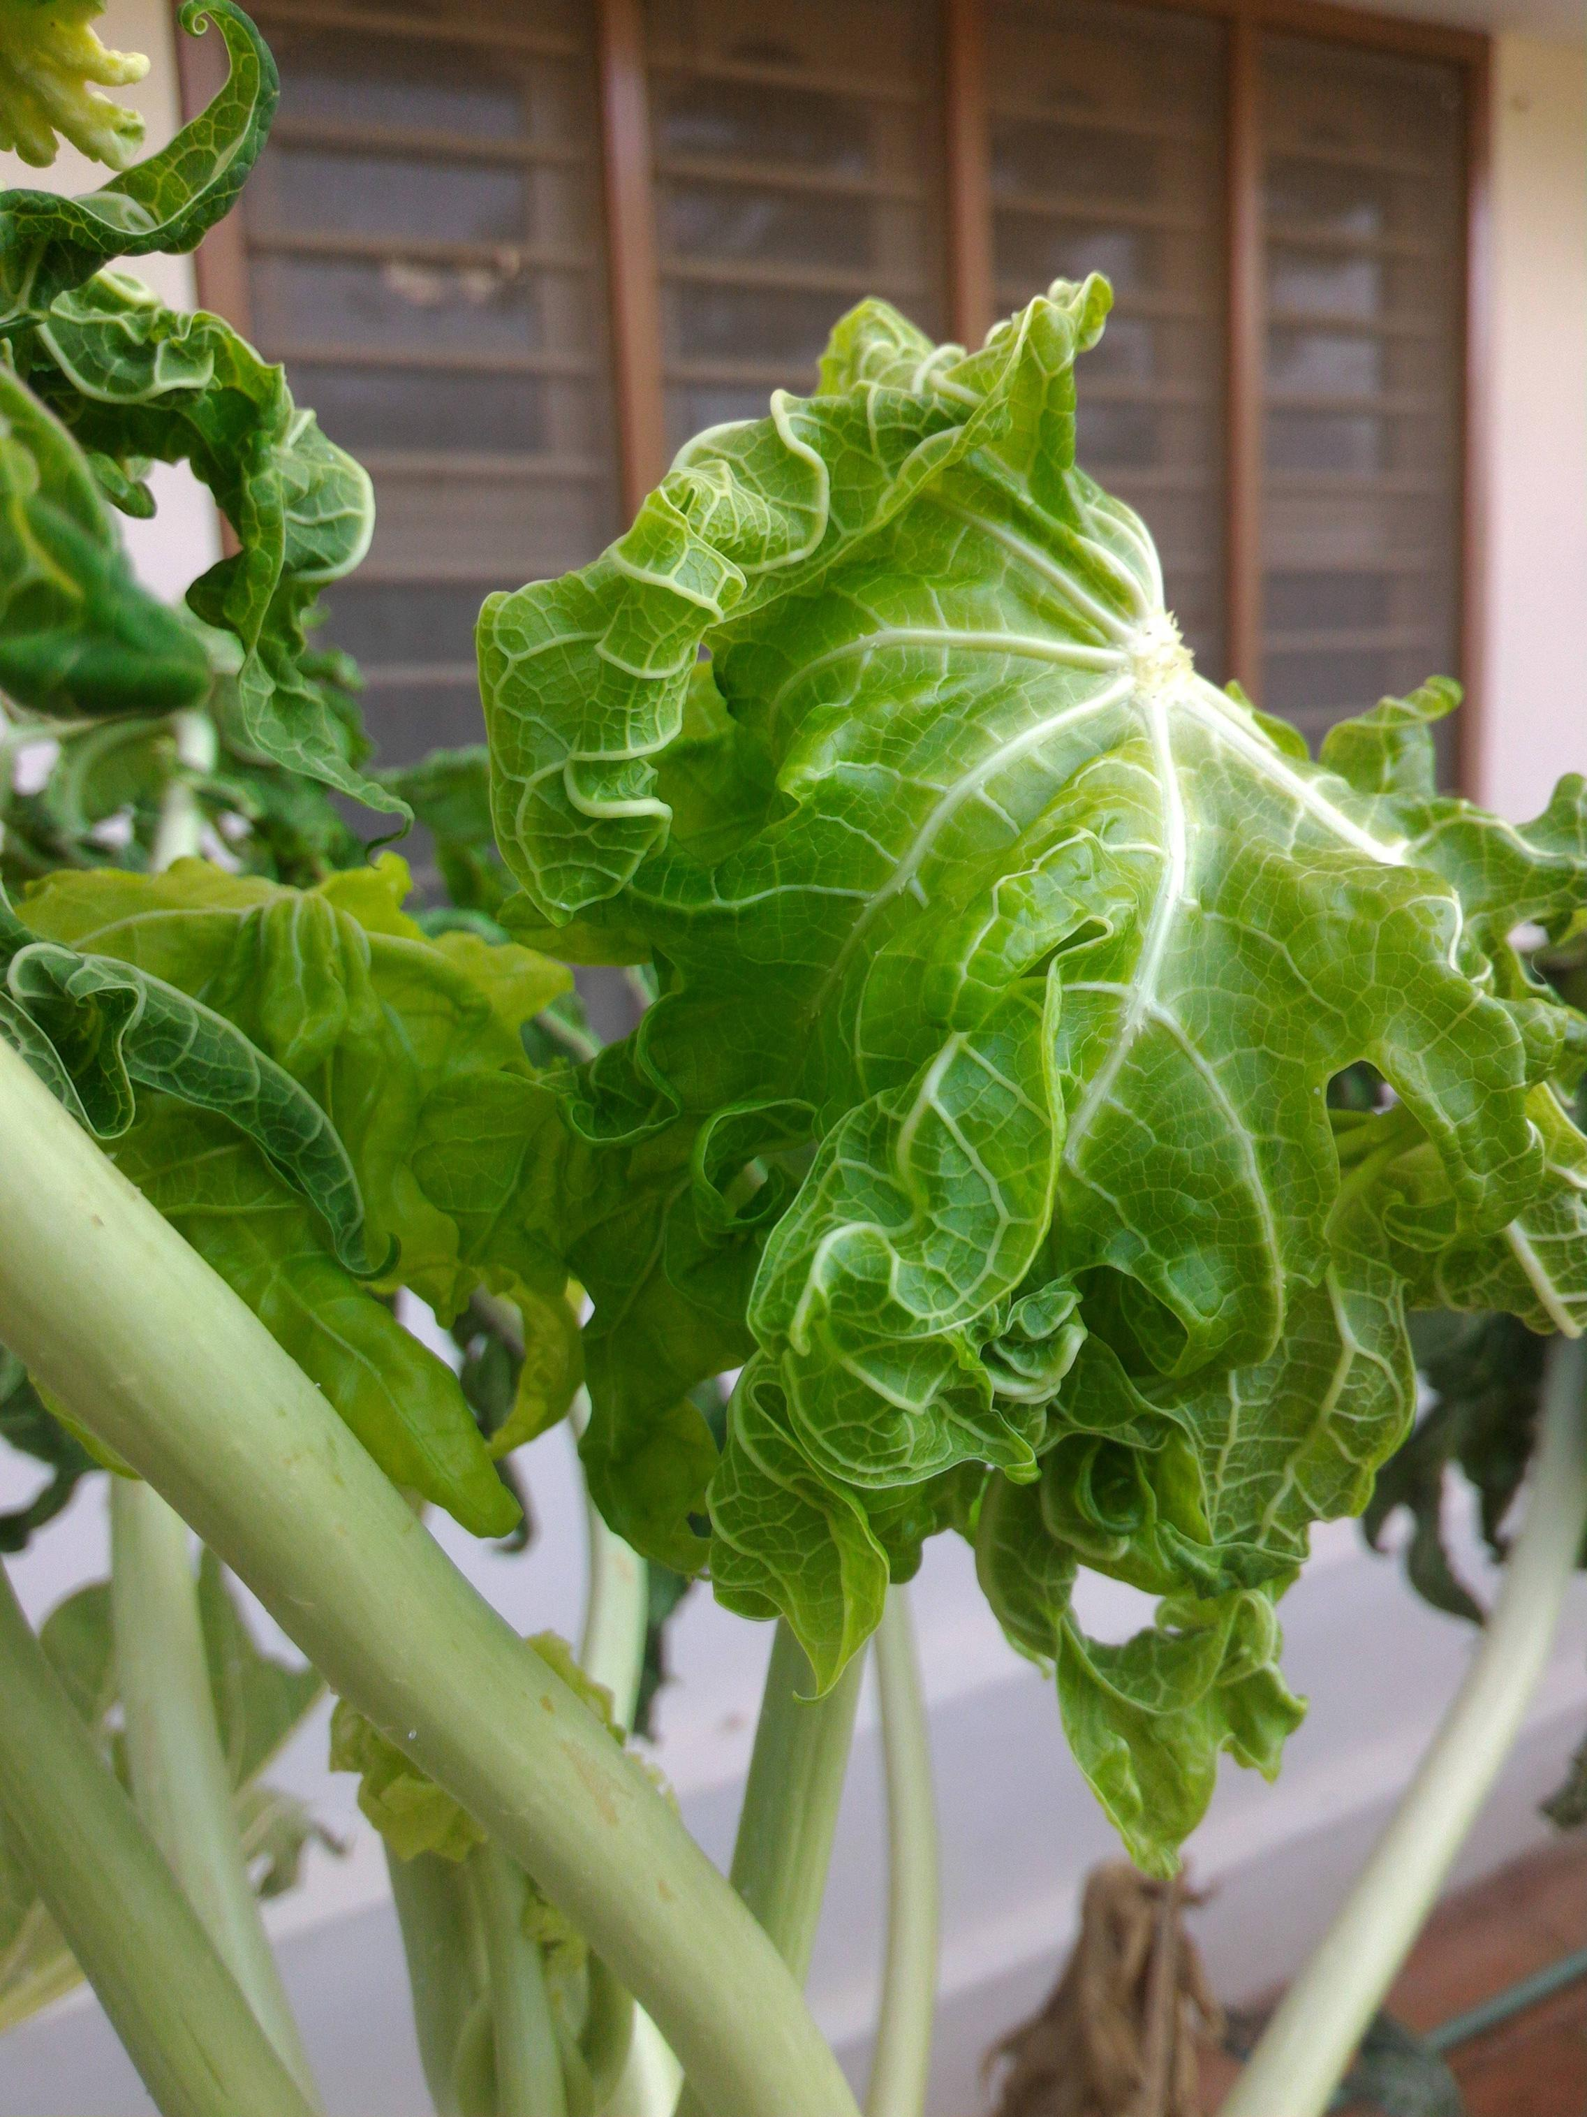
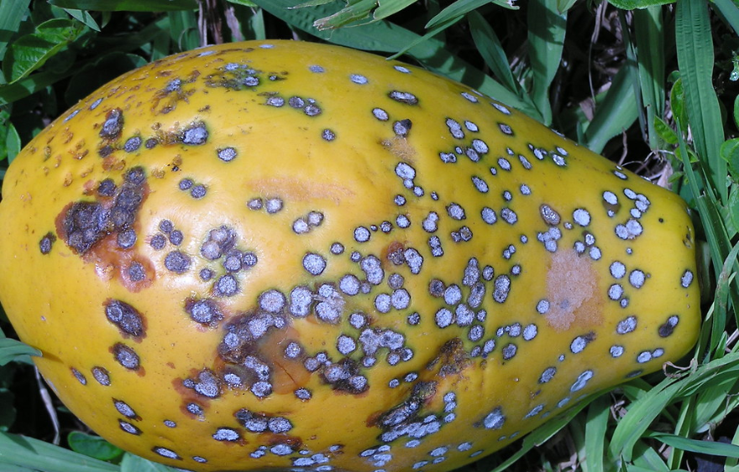
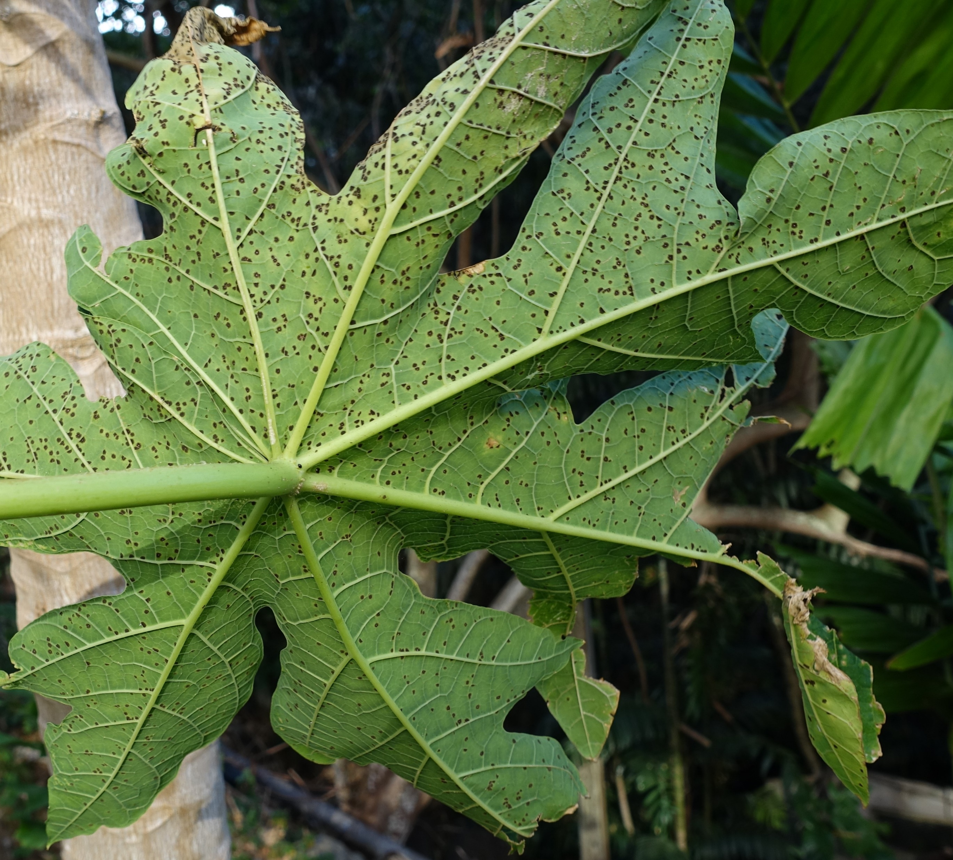
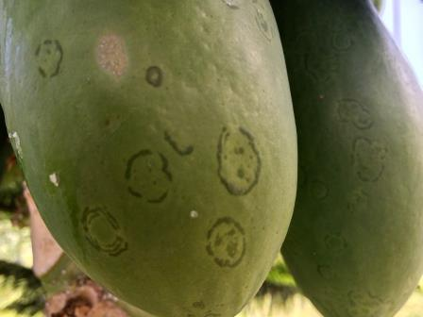
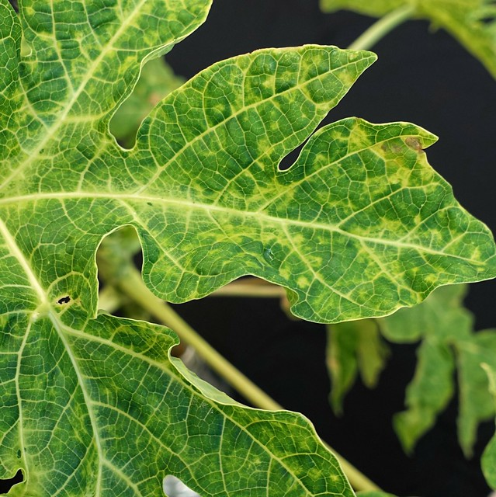
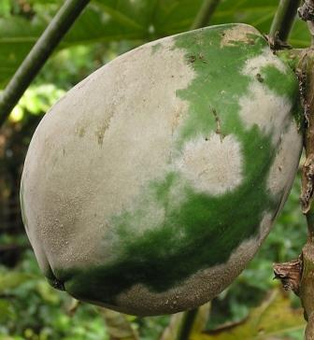
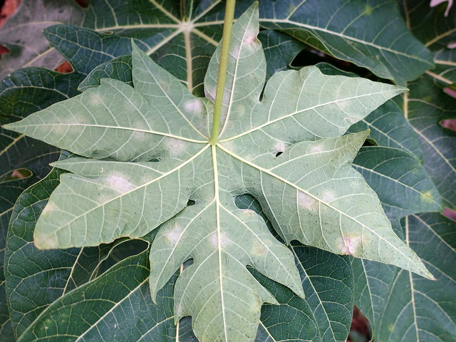
Goal
To recognize papaya diseases from papaya images.
Papaya Fresh Fruit Papaya Fresh Leaf Fruit Papaya Anthracnose Papaya Leaf Curl
Fruit Leaf Fruit Leaf Fruit Leaf
Papaya Blackspot Papaya Ringspot Papaya Powdery Mildew
Figure 1: Sample papaya diseases.

Slide 4
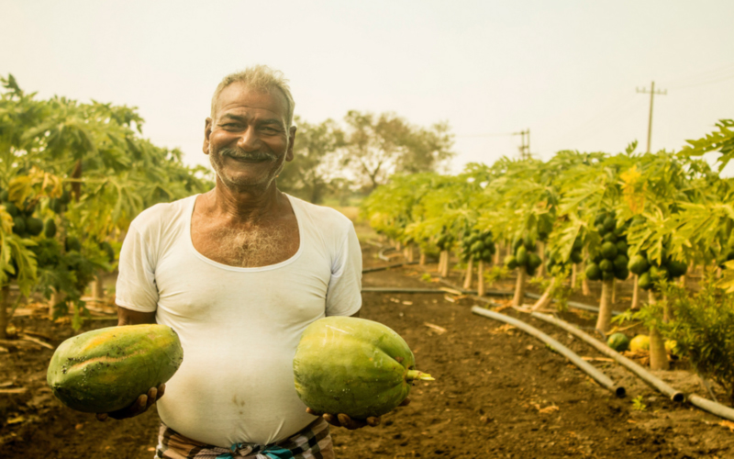
Motivations
Excellent research opportunity.
Growth of high quality products.
Reducing difficulties of existing works.
Detecting Diseases of papaya in real life scenario.
Figure 2: Happy farmer with good harvest.

Slide 5
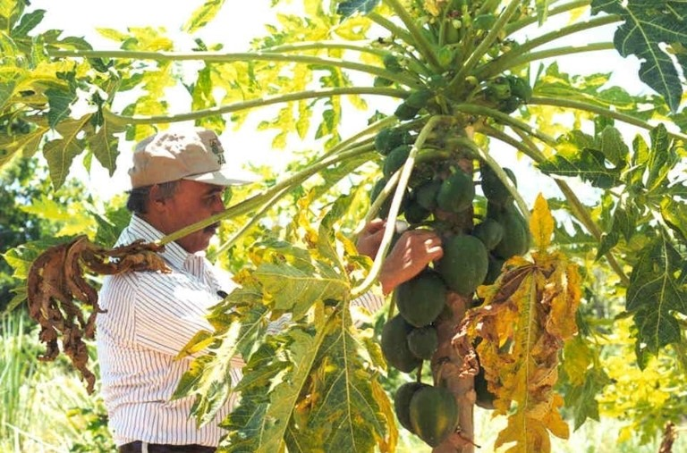
Applications
Assisting farmers with precise diseases detection.
Identifying disease at early stage.
Controlling massive losses and ensuring quality of product.
Figure 3: Identifying infected plant.

Slide 6
Related Works
Reference | Proposed Method | Limitations
R. K. Veeraballiet al. [1] | Applied CNN with resnet50 architecture in their method. | Only two leaf diseases, papaya mosaic and leaf curl were detected. No fruit diseases were added.
[1] R. K. Veeraballi, M. S. Nagugari, C. S. R. Annavarapu, and E. V. Gownipuram, “Deep Learning Based Approach for Classification and Detection of Papaya Leaf Diseases,” Advances in Intelligent Systems and Computing Intelligent Systems Design and Applications, pp. 291–302, Dec. 20
Reference | Proposed Method | Limitations
M. A. Islam et al. [2] | Proposed a method where they used K- means clustering for segmentation. Random forest classifier for classification. | Papaya fruit diseases were detected only. No papaya leaf diseases were included.
[2] M. A. Islam, M. S. Islam, M. S. Hossen, M. U. Emon, M. S. Keya and A. Habib, "Machine Learning based Image Classification of Papaya Disease Recognition," 2020 4th International Conference on Electronics, Communication and Aerospace Technology (ICECA), Coimbatore, India, 2020, pp. 1353-1360, doi: 10.1109/ICECA49313.2020.9297570.

Slide 7
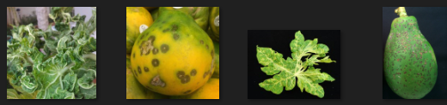
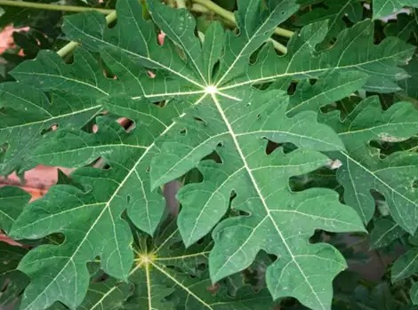
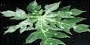
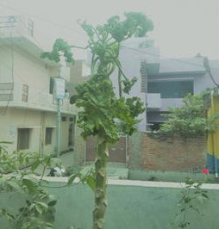
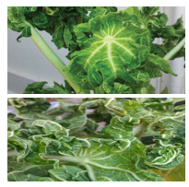
Overall Challenges
Dataset Collection
Object staying static for a several seconds might merge with the background.
Low resolution
Obscurity in an image
Different camera
orientation

Slide 8
The Proposed Framework
Papaya Image
Preprocessing
(Resizing, RGB to Grayscale, Enhancement)
Image Segmentation
(K-Means)
Classification (KNN)
Feature Extraction
Diseases Class
Figure 4: The proposed framework for papaya diseases recognition.

Slide 9
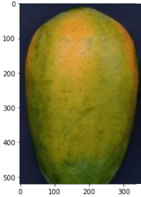
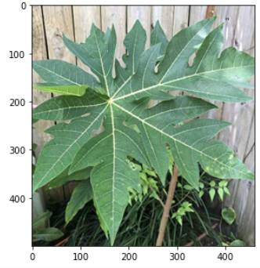
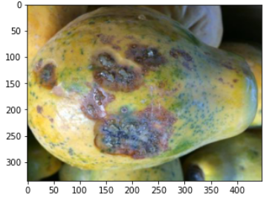
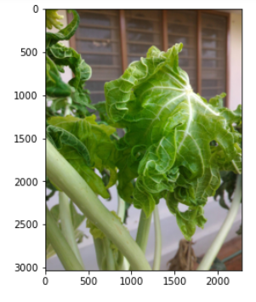
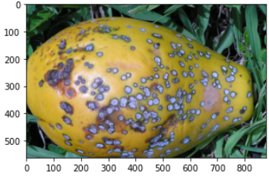
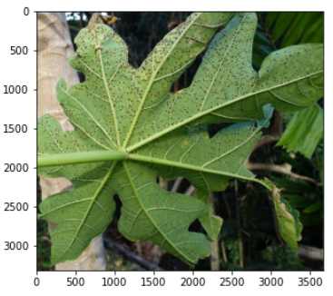
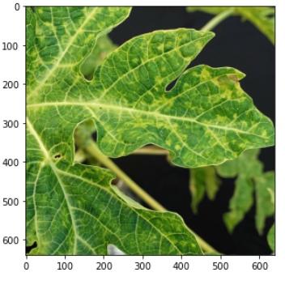
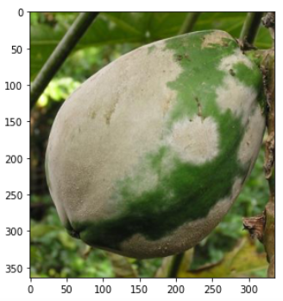
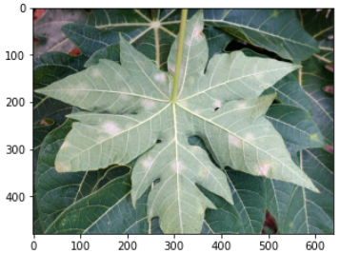
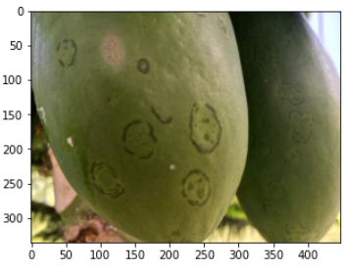
Implementation (Input Image)
Input Images:
The papaya fruits and leaves input image samples.
Papaya Fresh Fruit Papaya Fresh Leaf Fruit Papaya Anthracnose Papaya Leaf Curl
Fruit Leaf Fruit Leaf Fruit Leaf
Papaya Blackspot Papaya Ringspot Papaya Powdery Mildew
Figure 5: Input images.

Slide 10
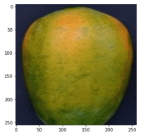
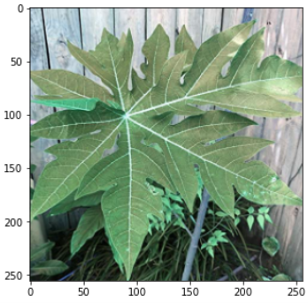
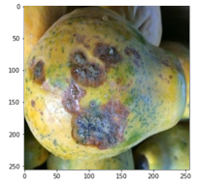
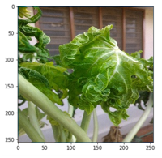
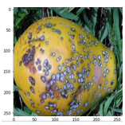
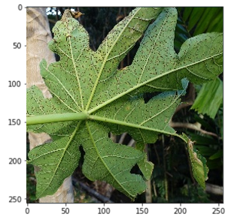
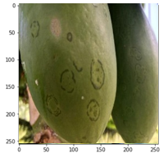
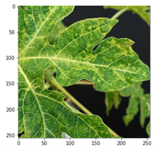
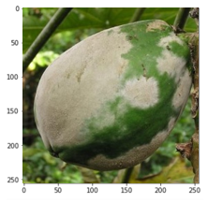
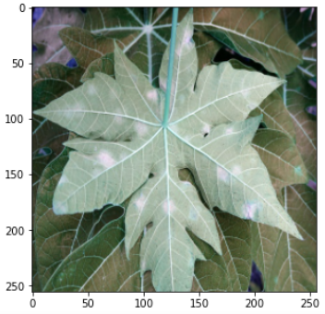
Implementation (Preprocessing)
Resizing of Images:
The images are resized to 256×256 resolution.
Papaya Fresh Fruit Papaya Fresh Leaf Fruit Papaya Anthracnose Papaya Leaf Curl
Fruit Leaf Fruit Leaf Fruit Leaf
Papaya Blackspot Papaya Ringspot Papaya Powdery Mildew
Figure 6: Resized images.

Slide 11
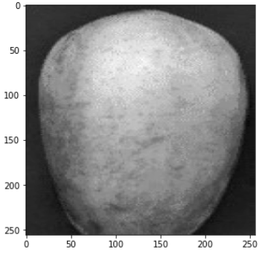
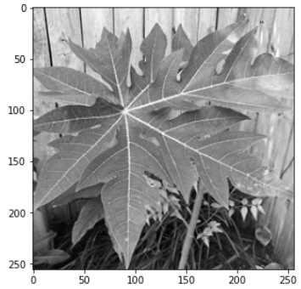
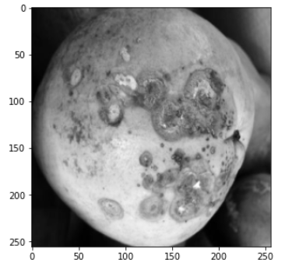
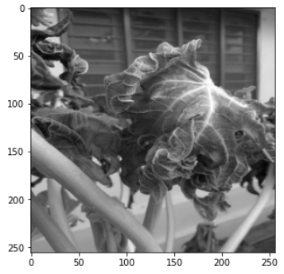
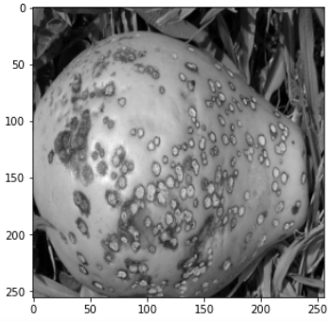
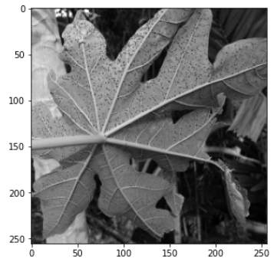
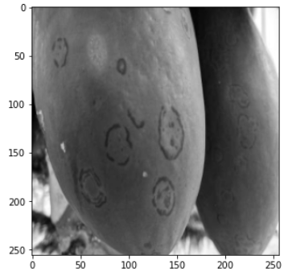
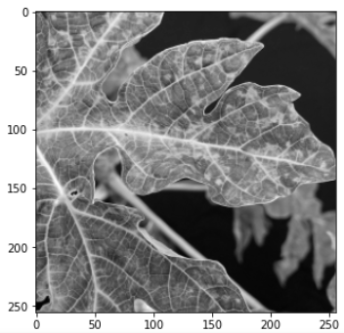
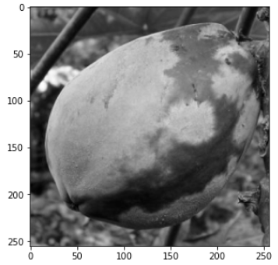
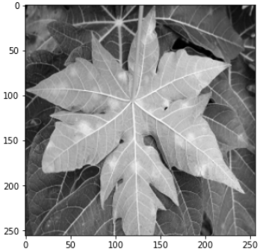
Preprocessing (Cont.)
Grayscale Conversion:
Grayscale conversion of RGB images.
Papaya Fresh Fruit Papaya Fresh Leaf Fruit Papaya Anthracnose Papaya Leaf Curl
Fruit Leaf Fruit Leaf Fruit Leaf
Papaya Blackspot Papaya Ringspot Papaya Powdery Mildew
Figure 7: Grayscale conversion.

Slide 12
Preprocessing (Cont.)
Histogram Equalization:
Histogram equalization is a image enhancement technique for adjusting image intensity to enhance contrast.
Histogram equalization can be implemented in both globally or locally.

Slide 13
Preprocessing (Cont.)
Global Histogram Equalization:
Applying global histogram equalization on grayscale images.
Papaya Fresh Fruit Papaya Fresh Leaf Fruit Papaya Anthracnose Papaya Leaf Curl
Fruit Leaf Fruit Leaf Fruit Leaf
Papaya Blackspot Papaya Ringspot Papaya Powdery Mildew
Figure 8: Histogram equalization (Global).

Slide 14
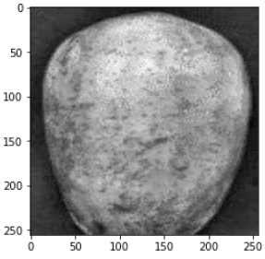
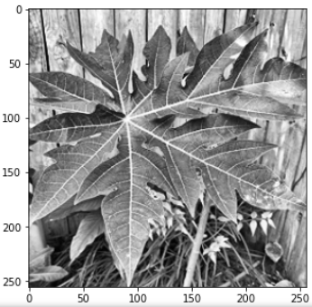
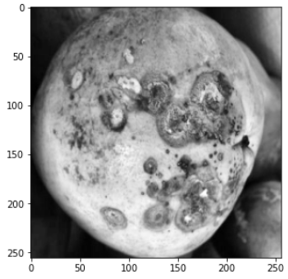







Preprocessing (Cont.)
Local Histogram Equalization:
For local histogram equalization we have applied CLAHE.
Papaya Fresh Fruit Papaya Fresh Leaf Fruit Papaya Anthracnose Papaya Leaf Curl
Fruit Leaf Fruit Leaf Fruit Leaf
Papaya Blackspot Papaya Ringspot Papaya Powdery Mildew
Figure 9: CLAHE images.

Slide 15



Preprocessing (Cont.)
Here papaya leaf blackspot disease is taken as an example.
Where CLAHE is applied in tile or blocks (M×M).
For different block sizes (M×M) are demonstrated in the CLAHE image.
We selected the 128×128 block as it gives the optimal result.
64×64 128×128 192×192
Figure 10: CLAHE applied in papaya blackspot.

Slide 16
Preprocessing (Cont.)
Histogram Comparison:
No change in mean intensity values between grayscale and histogram equalization
After applying CLAHE we can see significant difference in mean intensity values.
We have applied CLAHE when the mean intensity value is less than 150.

Slide 17




Preprocessing (Cont.)
As an example to show the histograms we chose papaya blackspot fruit and leaf image samples and the color black was used.
Histogram of Grayscale Histogram of Histogram Equalization (Global) Histogram of CLAHE
Histogram of Grayscale Histogram of Histogram Equalization (Global) Histogram of CLAHE
a)
b)
Figure 11: Histogram comparison of papaya blackspot a) fruit b) leaf.

Slide 18
Implementation (Segmentation)
K-Mean Image Segmentation:
K-Means is used to identify different clusters in the given data based on how similar the data is.
Data points in the same group are more similar than data points in other groups.
In K-Mean euclidean distance, is used to calculate clustering each data point from the data point to every cluster.
Euclidean distance =√((x1 - x2)² + (y1 - y2)²)
Where (x1, y1) & (x2, y2) are two data points

Slide 19










Segmentation (Cont.)
K-Mean Image Segmentation Using Automated Elbow Method:
Applying the automated elbow K-mean image segmentation method.
Papaya Fresh Fruit Papaya Fresh Leaf Fruit Papaya Anthracnose Papaya Leaf Curl
Fruit Leaf Fruit Leaf Fruit Leaf
Papaya Blackspot Papaya Ringspot Papaya Powdery Mildew
Figure 12: K-Mean image segmentation (automated elbow method).

Slide 20










Segmentation (Cont.)
Traditional K-Mean method.
Papaya Fresh Fruit Papaya Fresh Leaf Fruit Papaya Anthracnose Papaya Leaf Curl
Fruit Leaf Fruit Leaf Fruit Leaf
Papaya Blackspot Papaya Ringspot Papaya Powdery Mildew
Figure 13: K-Mean image segmentation (traditional method).

Slide 21

Segmentation (Cont.)
K-Mean Methods Comparison:
Papaya leaf blackspot disease is taken as an example to show comparsion.
Figure 14: K-Mean method comparison.

Slide 22
Implementation (Feature Extraction)
GLCM Feature Properties:
Contrast
Homogeneity
Energy
Correlation
Directions of analysis:
Horizontal (0 degree)
Vertical (90 degree)
Diagonal:
a) Bottom left to top right (45 degree)
b) Top left to bottom right (135 degree)

Slide 23









Feature Extraction (Cont.)
Here papaya leaf blackspot is taken as an example.
a)

Slide 24

Feature Extraction (Cont.)
Contrast_0 | Contrast_45 | Contrast_90 | Contrast_135
1.873560049 | 2.629711649 | 1.381479779 | 2.745251826
homogeneity_0 | homogeneity_45 | homogeneity_90 | homogeneity_135
0.671860708 | 0.623328937 | 0.704369327 | 0.614936734
energy_0 | energy_45 | energy_90 | energy_135
0.175575944 | 0.163910918 | 0.182929669 | 0.162269061
correlation_135 | correlation_45 | correlation_90 | correlation_135
0.95214654 | 0.932817412 | 0.964711681 | 0.929808705
b)
Figure 15: Feature extraction using feature (papaya leaf blackspot):
a) feature properties visualization b) feature properties map with values.

Slide 25
Implementation (Classification)
The k-nearest neighbors (KNN) algorithm is a simple, supervised machine learning algorithm.
KNN finds the distances between a query and all the examples in the data.
Selects the specified number examples (K) closest to the query, then votes for the most frequent label.
To calculate the euclidean distance of K number of neighbors the formula below is used:
Euclidean distance =√((x1 - x2)² + (y1 - y2)²)

Slide 26
Hardware Configuration
Platform | Memory | GPU | Framework | Programming Language
Jupyter Notebook | 16 GB RAM | NVDIA GEFORCE 960M | Scikitlearn | Python 3.7

Slide 27

Dataset Description
Dataset with ten classes of papaya diseases image sample.
There are total of 610 papaya leaf images within ten folders for ten classes.
There are 265 papaya fruit images and 345 papaya leaf images in the dataset.
Figure 16: Papaya image dataset directory folder

Slide 28
Dataset Description (Cont.)
Disease Name | Amount
Fruit Fresh Papaya | 55
Fruit Papaya Anthracnose | 65
Fruit Papaya Black Spot | 47
Fruit Papaya Powdery Mildew | 42
Fruit Papaya Ringspot | 56
Fruit | 265
Papaya Fresh Leaf | 68
Papaya Leaf Black Spot | 88
Papaya Leaf Curl | 45
Papaya Leaf Powdery Mildew | 70
Papaya Leaf Ringspot | 73
Leaf | 345

Slide 29
Dataset Description (Cont.)
All the image samples are collected by contacting various agricultural institutions such as BARC, BAU, Krishi Institution Bangladesh along with some attempted captures.
The internet sources are following,
https://archive.ics.uci.edu/
https://www.padil.gov.au
https://gms.ctahr.hawaii.edu
https://plantvillage.psu.edu
https://data.mendeley.com/

Slide 30


Result & Discussion
Confusion Matrix:
a) b)
Figure 17: Confusion matrix a) train b) test

Slide 31

Result & Discussion (Cont.)
From the variation of accuracy graph for k=3 we get the best result.
Figure 18: Variation of accuracy with k value.

Slide 32

Result & Discussion (Cont.)
The error rate graph demonstrates for k=3 the error rate is lower.
Figure 19: Error rate vs k value.

Slide 33





Result & Discussion (Cont.)
Fruit Fresh Papaya Fruit Papaya Anthracnose Fruit Papaya Black Spot
Fruit Papaya Powdery Mildew Fruit Papaya Ringspot
a)

Slide 34



Result & Discussion (Cont.)
Papaya Fresh Leaf Papaya Leaf Black Spot Papaya Leaf Curl
Papaya Leaf Powdery Mildew Papaya Leaf Ringspot
b)
Figure 20: ROC curve of our proposed framework a) fruit b) leaf.

Slide 35
Result & Discussion (Cont.)
Performance Parameter values of the classification result of KNN.
Disease Name | Precision | Recall | F1-Score | Accuracy
Fruit Fresh Papaya | 0.82 | 0.78 | 0.79 | 0.80
Fruit Papaya Anthracnose | 1.00 | 0.95 | 0.97 | 0.97
Fruit Papaya Black Spot | 0.86 | 0.90 | 0.93 | 0.88
Fruit Papaya Powdery Mildew | 0.75 | 0.87 | 0.82 | 0.83
Fruit Papaya Ringspot | 0.91 | 1.00 | 0.97 | 0.98
Papaya Fresh Leaf | 0.81 | 0.95 | 0.85 | 0.85
Papaya Leaf Black Spot | 0.92 | 0.96 | 0.90 | 0.92
Papaya Leaf Curl | 0.77 | 0.85 | 0.82 | 0.83
Papaya Leaf Powdery Mildew | 0.85 | 1.00 | 0.83 | 0.84
Papaya Leaf Ringspot | 0.82 | 0.89 | 0.87 | 0.87
Average | 85.1% | 91.5% | 87.5% | 87.6%

Slide 36

Result & Discussion (Cont.)
Diseases classified in KNN:
Here,
0 indicates Fruit Fresh Papaya
1 indicates Fruit Papaya Anthracnose
2 indicates Fruit Papaya Black Spot
3 indicates Fruit Papaya Powdery Mildew
4 indicates Fruit Papaya Ringspot
5 indicates Papaya Fresh Leaf
6 indicates Papaya Leaf Black Spot
7 indicates Papaya Leaf Curl
8 indicates Papaya Leaf Powdery Mildew
9 indicates Papaya Leaf Ringspot
Figure 21: Diseases classified in KNN.

Slide 37

Result & Discussion (Cont.)
Sample output of our proposed papaya diseases recognition framework.
a) b)
Figure 22: Output result: a) fruit b) leaf.

Slide 38
Result & Discussion (Cont.)
Different machine learning algorithms with their accuracy.
Algorithm | Accuracy
Our Proposed KNN Method | 87.6%
SVM | 82.1%
Random Forest | 78.2%
Naive Bayes | 75.8%
Logistic regression | 75.8%
Decision Tree | 76.4%

Slide 39

Result & Discussion (Cont.)
Performance analysis of different models.
Figure 23: Bar chart showing performance analysis of different models.

Slide 40
Result & Discussion (Cont.)
Comparison with study [2].
Disease Name | Precision | Recall | F1-Score | Accuracy
Papaya Anthracnose | 0.94 | 0.94 | 0.94 | 0.94
Papaya Black Spot | 0.88 | 0.94 | 0.92 | 0.94
Papaya Powdery Mildew | 0.80 | 0.78 | 0.79 | 0.81
Papaya Ringspot | 1.00 | 0.94 | 0.95 | 0.98
Algorithm | Fruit Papaya Anthracnose | Fruit Papaya Black Spot | Fruit Papaya Powdery Mildew | Fruit Papaya Ringspot
Our KNN Proposed Method | 94% | 94% | 81% | 98%
RF Method [2] | 88.9% | 94.5% | 98% | 97.3%

Slide 41
Conclusion
We proposed a framework that can work on real-world scenario.
In our knowledge there has not been any combined approach done before.
We implemented some image preprocessing techniques for better outcome then segmented images after that extracted feature and finally classified the diseases.
The total run time of pre-processing and training time of the process was around 75 minutes and it took the system about 1.075 second to detect the output.
We also compared with different machine learning algorithms.

Slide 42
Limitations & Future Work
As our dataset does not contain a large number of images, creation of a bigger dataset may provide better result.
Our dataset is imbalanced, thus working with a more balanced dataset may result in better outcome.
More fine-tuning to obtain better performance.
Deep Learning approach may be taken.

Slide 43
Reference
[1] R. K. Veeraballi, M. S. Nagugari, C. S. R. Annavarapu, and E. V. Gownipuram,“Deep Learning Based Approach for Classification and Detection of Papaya Leaf Diseases,” Advances in Intelligent Systems and Computing Intelligent Systems Design and Applications, pp. 291–302, Dec. 2019.
[2] M. A. Islam, M. S. Islam, M. S. Hossen, M. U. Emon, M. S. Keya and A. Habib, "Machine Learning based Image Classification of Papaya Disease Recognition," 2020 4th International Conference on Electronics, Communication and Aerospace Technology (ICECA), Coimbatore, India, 2020, pp. 1353-1360, doi: 10.1109/ICECA49313.2020.9297570.
[3] D.Femi1, S.Thylashri2, J.Raja Paulsingh3. “Detection and Recognition of Papaya Leaf Diseases Using Image Processing” International Journal of Advanced Science and Technology Vol. 29, No. 9s, (2020), pp. 137-142.
[4] M. S. Hossen, I. Haque, M. S. Islam, M. T. Ahmed, M. J. Nime and M. A. Islam, "Deep Learning based Classification of Papaya Disease Recognition," 2020 3rd International Conference on Intelligent Sustainable Systems (ICISS), Thoothukudi, India, 2020, pp. 945-951, doi: 10.1109/ICISS49785.2020.9316106.
[5] E. Hossain, M. F. Hossain, and M. A. Rahaman, “A Color and Texture Based Approach for the Detection and Classification of Plant Leaf Disease Using KNN Classifier,” 2nd Int. Conf. Electr. Comput. Commun. Eng. ECCE 2019, pp. 1–6, 2019, doi: 10.1109/ECACE.2019.8679247.
[6] Hall-Beyer, Mryka. “GLCM Texture: A Tutorial v. 3.0” March 2017. (2017).

Slide 44

Thank You

Slide 45

Appendix – Dataset Description
The distribution of image samples in the dataset.

Slide 46




Appendix – Histogram Comparison
To show the histograms of papaya fresh fruit and leaf image samples the color green was used.
Histogram of Grayscale Histogram of Histogram Equalization (Global) Histogram of CLAHE
Histogram of Grayscale Histogram of Histogram Equalization (Global) Histogram of CLAHE
a)
b)
Figure : Histogram comparison of papaya fresh a) fruit b) leaf.

Slide 47


Appendix – Histogram Comparison
For papaya fruit anthracnose histogram, the color brown was taken into consideration.
Histogram of Grayscale Histogram of Histogram Equalization (Global) Histogram of CLAHE
Figure 12: Histogram comparison of fruit anthracnose.

Slide 48


Appendix – Histogram Comparison
For papaya leaf curl image samples the color blue is used.
Histogram of Grayscale Histogram of Histogram Equalization (Global) Histogram of CLAHE
Figure : Histogram comparison of papaya leaf curl.

Slide 49




Appendix – Histogram Comparison
To show the histograms of papaya ringspot fruit and leaf image samples the color red was used.
Histogram of Grayscale Histogram of Histogram Equalization (Global) Histogram of CLAHE
Histogram of Grayscale Histogram of Histogram Equalization (Global) Histogram of CLAHE
a)
b)
Figure : Histogram comparison of papaya ringspot a) fruit b) leaf.

Slide 50




Appendix – Histogram Comparison
To show the histograms of papaya powdery mildew fruit and leaf image samples the color teal was used.
Histogram of Grayscale Histogram of Histogram Equalization (Global) Histogram of CLAHE
Histogram of Grayscale Histogram of Histogram Equalization (Global) Histogram of CLAHE
a)
b)
Figure 16: Histogram comparison of papaya powdery mildew a) fruit b) leaf.

